Slide 1
Test Amplification in the Pharo Smalltalk Ecosystem
Mehrdad Abdi, Henrique Rocha, Serge Demeyer

Slide 2
Unit Testing
S
Covers
A
Test Case
S
S
A
S
A
A
Test Suite
Program (Unit under test)

Slide 3
Test Case
b := SmallBank new.
b deposit: 10.
b deposit: 90.
b withdraw: 99.
Setup
S
A
Assertion
self assert: b balance equals: 100.
✅
self assert: b balance equals: 0
❌

Slide 4
Mutation Testing
Mutation
S
S
☠️
🤪
A
S
A
P1
P2
A
Test Suite
🤪
☠️
P3
P4

Slide 5
Test Amplification
S
S’
S
S’
A
A
S
S’
A
A
A
A’
Test Suite
Amplified Test Suite
Program (Unit under test)

Slide 6
Test amplification consists of the automatic transformation of an existing manually written test suite, to enhance a specific, measurable property.
Definition:
[Danglot 2018] Benjamin Danglot, Oscar Vera-Perez, Zhongxing Yu, Andy Zaidman, Martin Monperrus, and Benoit Baudry. 2018. A Snowballing Literature Study on Test Amplification. arXiv paper 1705.10692v2 (2018).

Slide 7
Small-Amp
Small-Amp is a replication of Dspot [Danglot 2019] in Pharo
And is yet under development
DSpot is based on 2 techniques:
Input amplification
Evolutionary test generation [Tonella, 2004]
Assert amplification
Test oracle generation [Xie, 2006]
[Danglot 2019] Benjamin Danglot, Oscar Luis Vera-Pérez, Benoit Baudry, and Martin Monperrus. 2019. Automatic Test Improvement with DSpot: a Study with Ten Mature Open-Source Projects. Empirical Software Engineering, Springer Verlag (2019).
[Tonella, 2004] Paolo Tonella. 2004. Evolutionary testing of classes. Proceedings of the 2004 ACM SIGSOFT international symposium on Software testing and analysis - ISSTA ’04 (2004).
[Xie, 2006] Tao Xie. 2006. Augmenting Automatically Generated Unit-Test Suites with Regression Oracle Checking. Lecture Notes in Computer Science (2006), 380–403.

Slide 8
Initial population
S1
A1
S2
A2
S3
A3
…

Slide 9
Stripping: Removing assertions
S1
S1
A1
Stripping
S2
S2
A2
S3
S3
A3
…
…

Slide 10
Mutating: New versions of test-cases
S1
S1
S1-1
S1-2
…
Mutating
S2
S2
S2-1
S2-2
…
S3
S3
S3-1
S3-2
…
…
…
…
…

Slide 11
Carving: Inserting observation points
S1
S1-1
S1-2
…
S1*
S1-1*
S1-2*
…
Carving
S2
S2-1
S2-2
…
S2*
S2-1*
S2-2*
…
S3
S3-1
S3-2
…
S3*
S3-1*
S3-2*
…
…
…
…
…
…
…

Slide 12
Running: Executing test-cases
S1*
S1-1*
S1-2*
…
S1*
S1-1*
S1-2*
…
m1
m1-1
m1-2
Running
S2*
S2-1
S2-2*
…
S2*
S2-1
S2-2*
…
m2
m2-1
m2-2
S3*
S3-1*
S3-2*
…
S3*
S3-1*
S3-2*
…
m3
m3-1
m3-2
…
…
…
…
…
…

Slide 13
Assert Generation
S1*
S1-1*
S1-2*
…
S1
S1-1
S1-2
…
m1
m1-1
m1-2
A1
A1-1
A1-2
Assert-G
S2*
S2-1
S2-2*
…
S2
S2-1
S2-2
…
m2
m2-1
m2-2
A1
A2-1
A2-2
S3*
S3-1*
S3-2*
…
S3
S3-1
S3-2
…
A1
A3-1
A3-2
m3
m3-1
m3-2
…
…
…
…
…
…

Slide 14
Selection
S1
S1-1
S1-2
…
S2-1
A1
A1-1
A1-2
A2-1
Selection
S2
S2-1
S2-2
…
S3-2
A1
A2-1
A2-2
A3-2
S3
S3-1
S3-2
…
S7-6
A1
A3-1
A3-2
A7-6
…
…
…
…

Slide 15
Selection
Mutants
P1
Kills
S1
Original test-case
A1
P2
Amplified test-case
S1-1
A1-1
P3
👍
S1-2
P4
Amplified test-case
A1-2

Slide 16
Iteration N time
S2-1
S1
A2-1
A1
Next Generation
S3-2
S2
A3-2
A2
S7-6
S3
A7-6
A3
…
…

Slide 17
Input Amplification
Stripping
Mutating
Carving
S1-2
S1
S1
S1-2
S1-2
A1
S1-2
Repeating N times
S1-2
S1-2*
S1-1
S2-1
S1-2
S2-1
S1-2
A1-1
S1-2
S1-2*
A2-1
A2-1
A1-2
m1-2
Selecting
Assert Generating
Running
Assert Amplification

Slide 18
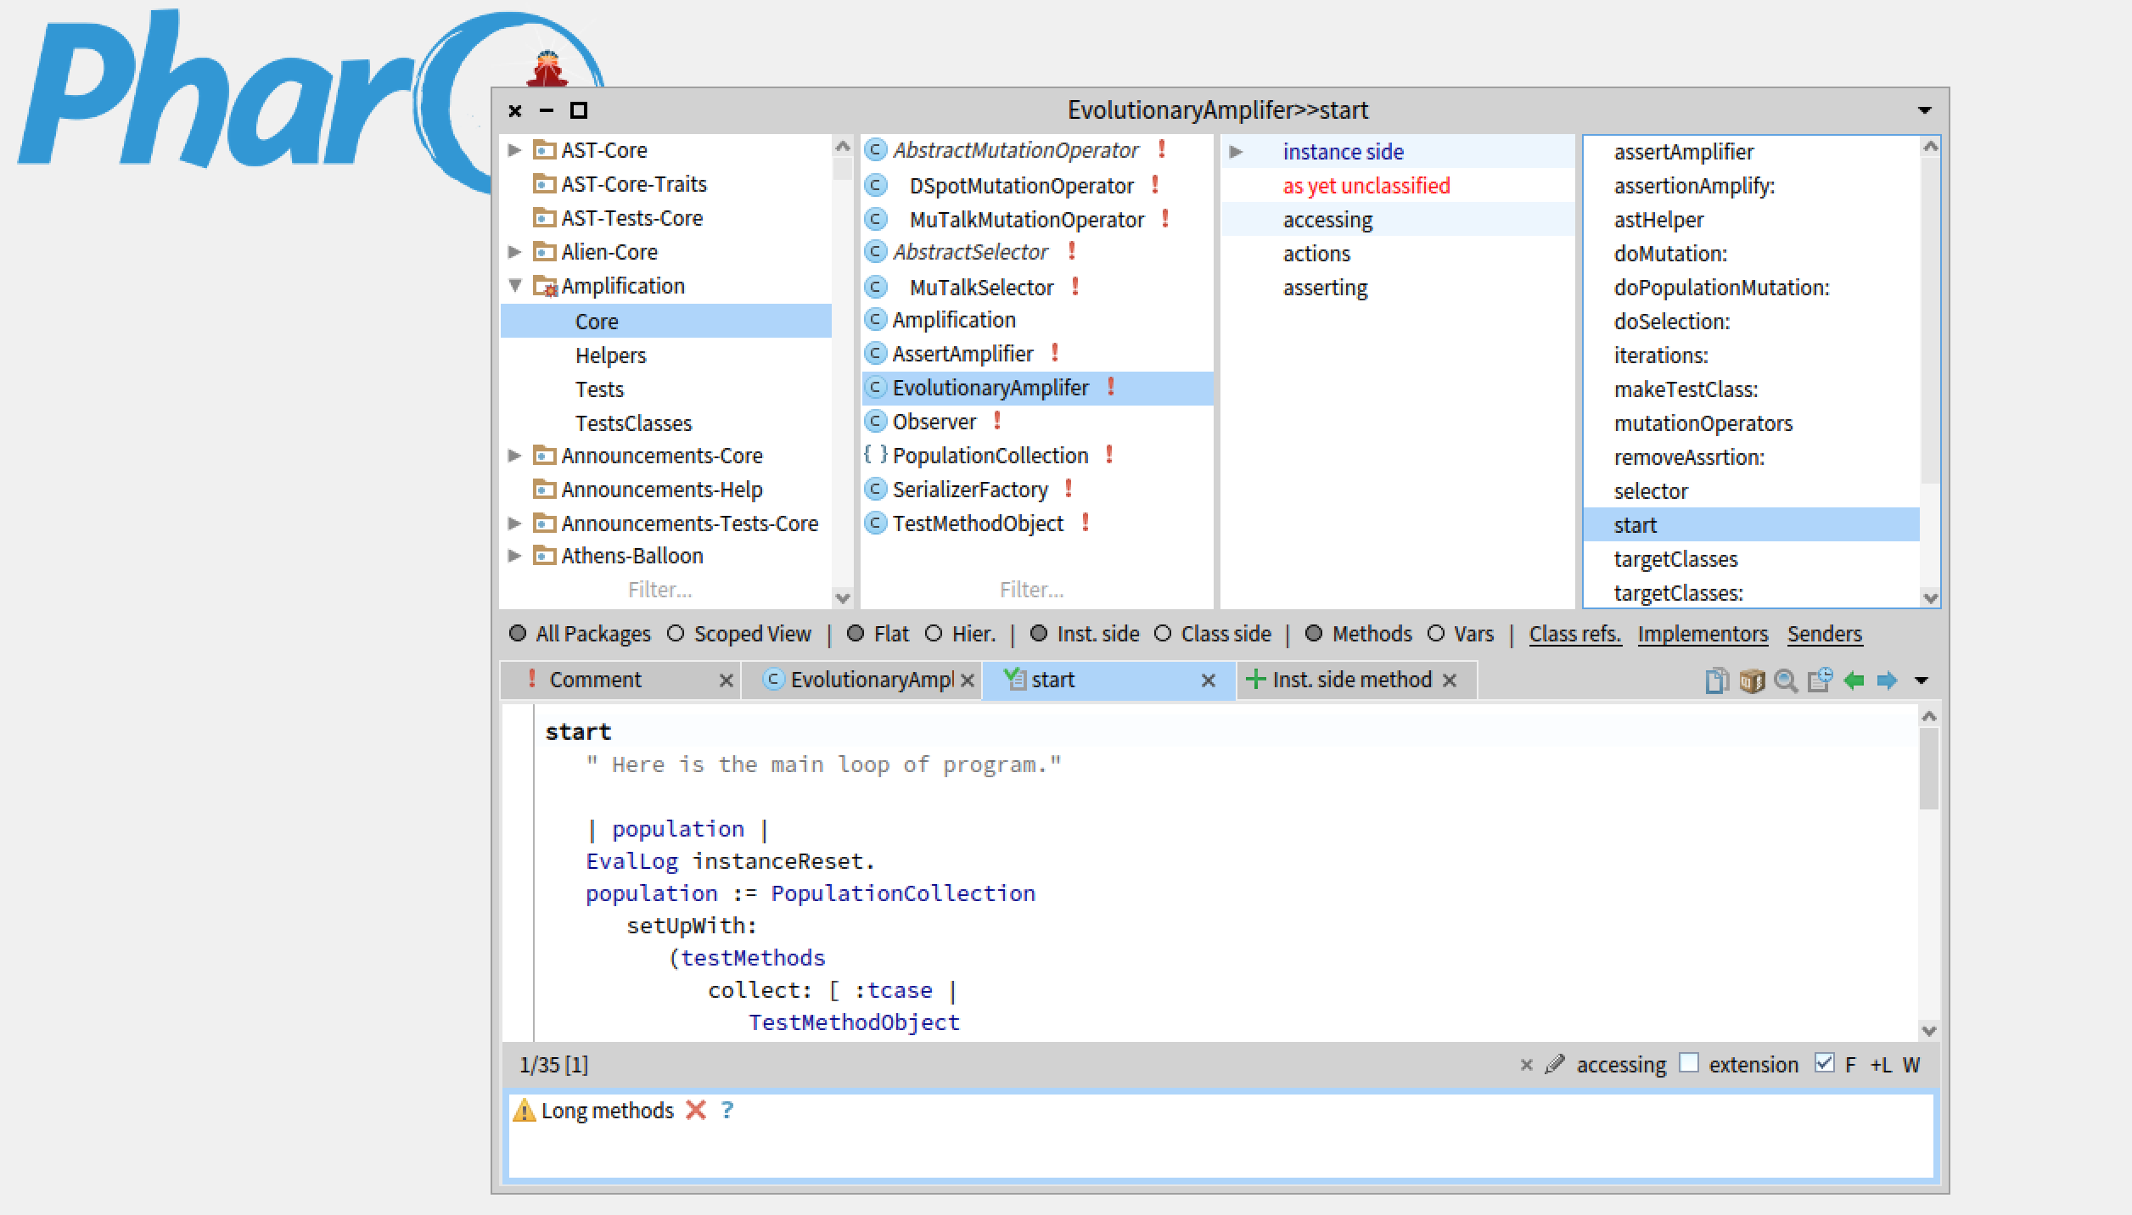
Implementation
https://github.com/mabdi/small-amp

Slide 19
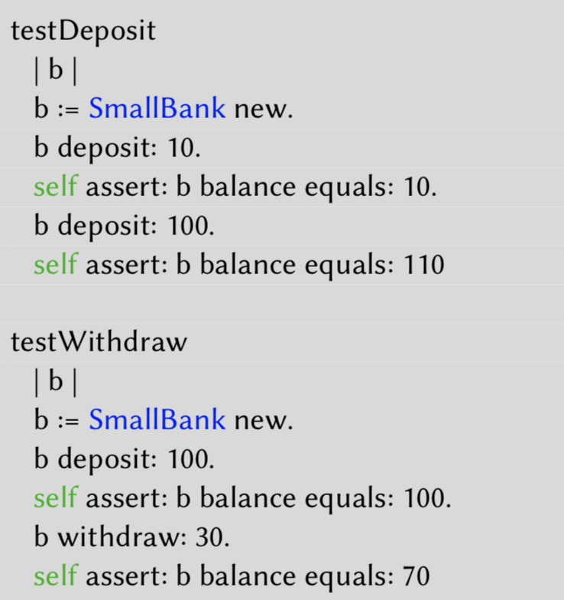

Slide 20
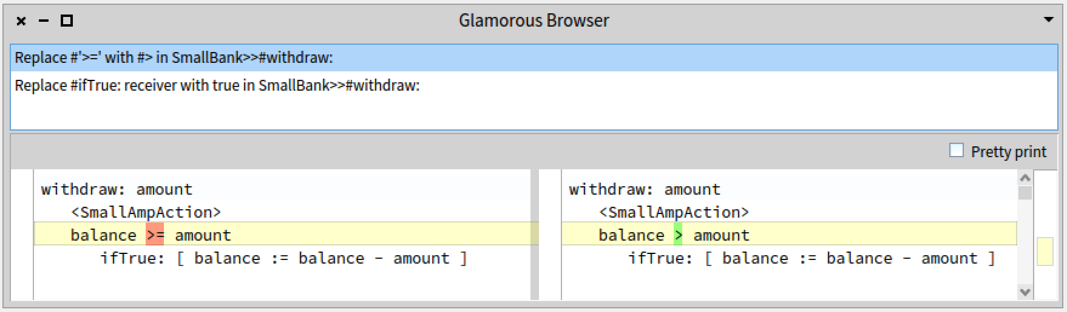
Mutation coverage

Slide 21
Lesson learned 1: Dynamic Language
Lack of static type system
Test body mutating
Literal mutation
Mutation analysis (Selection)
Former works: Smutant and MuTalk
Assert generation
It’s a dynamic process
Different structure
Cascades and nested message sends
Easy to normalize
Blocks (it’s ignored currently!)

Slide 22
Lesson learned 2: The costs
Number of temp variables
Assert amplify costs
Small number of iterations
Small N -> No evolution!

Slide 23
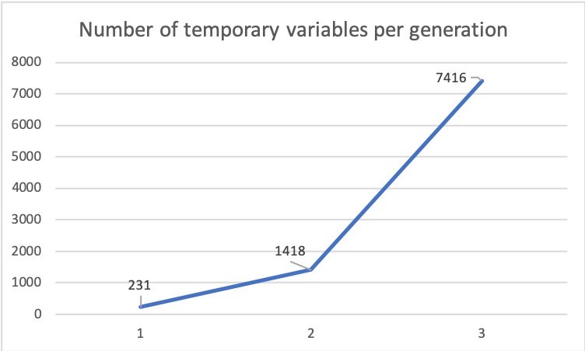
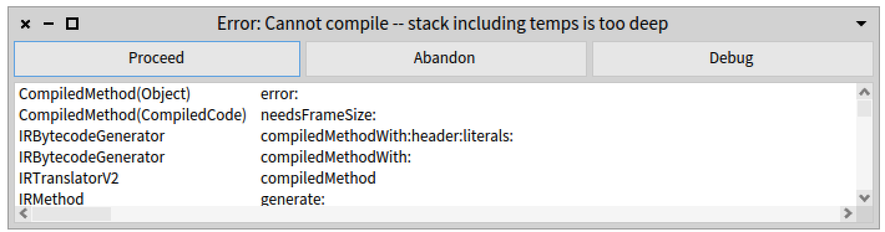

Slide 24
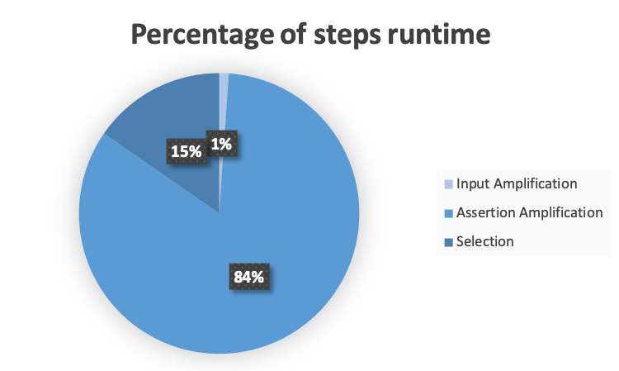

Slide 25
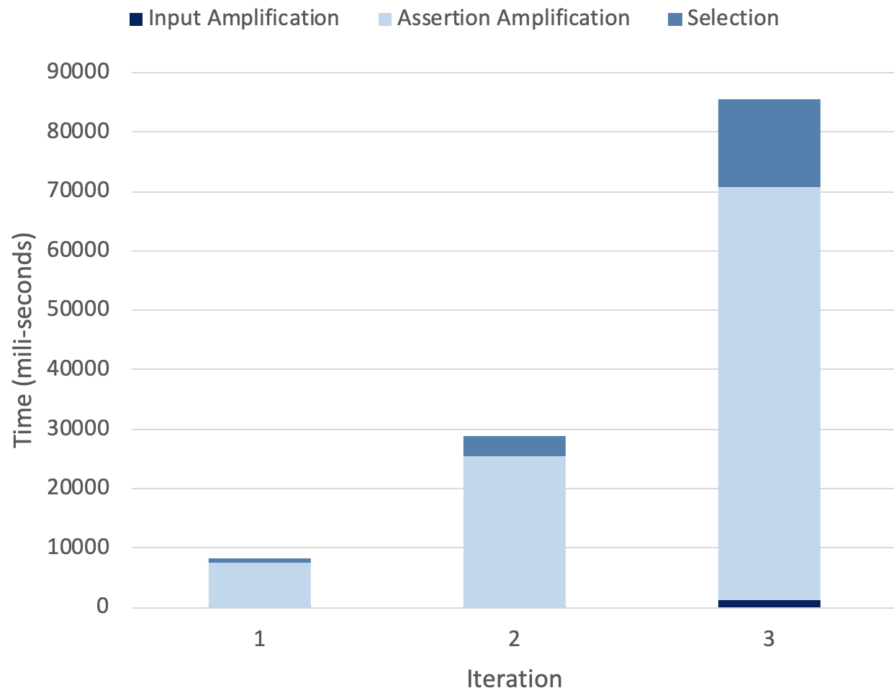
Run time performance per iteration

Slide 26
Lesson learned 3: Ugly result
Hard to understand
Hard to maintain

Slide 27
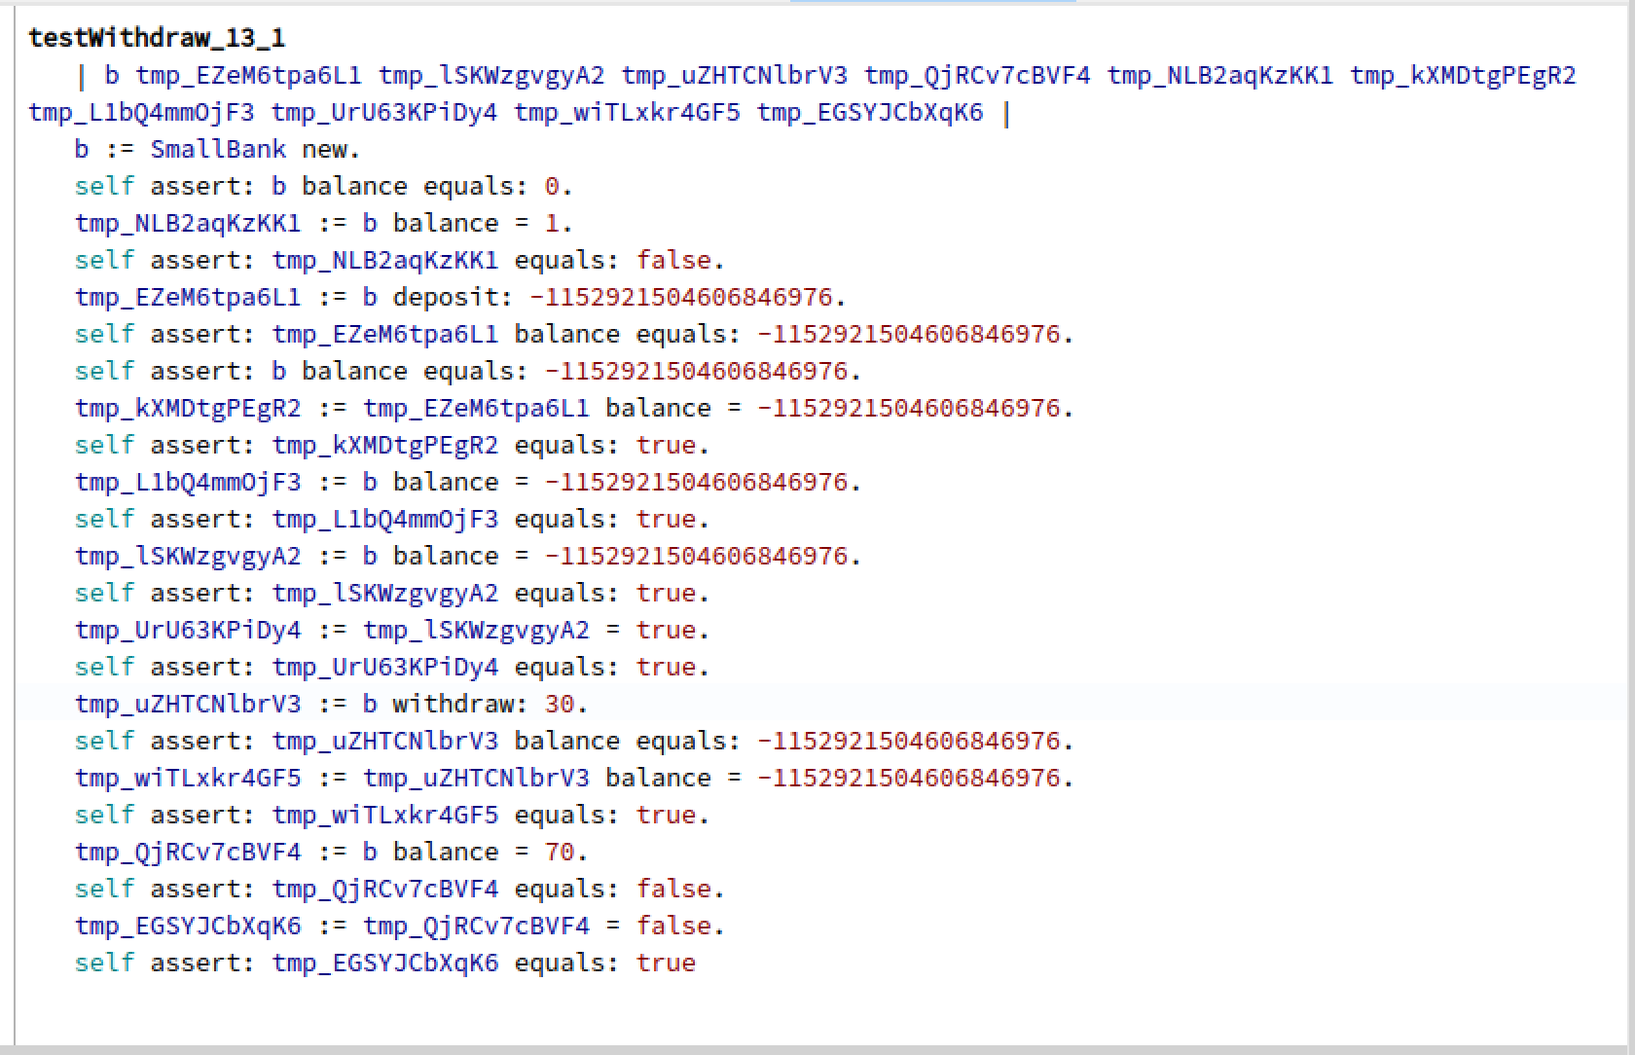
Too many temp variables
Some checks make no sense!
Or are redundant
Too many assert statements.
Strange random values

Slide 28
We have implemented
Clean-up extra code after each generation
Identify assertion statements that are redundant
Discard extra temp variables

Slide 29
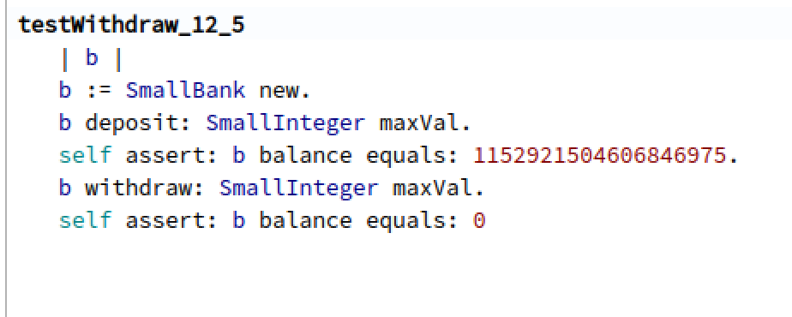

Slide 30
Next directions
Using test amplification in real application
With a mature test suite
Make generated tests more understandable
Modeling good tests
Building good tests

Slide 31
We welcome
Suggestions
Collaborations
Real applications
And else …

